Slide 1
SMART COMMUNICATION – PSC193
PIP2001 Capstone Project
Final Review
Batch Number: CSE-G125
Under the Supervision of,
Dr. / Mr. Dr.SukruthGowda M A
Professor / Associate Professor / Assistant Professor
School of Computer Science & Engineering
Presidency University
Roll Number | Student Name
20211CSE0062 | N Sai Dinesh
20211CSE0082 | Anandhu Pradeep
20211CSE0180 | Galiveeti Tharun reddy
Name of the Program:
Name of the HoD:
Name of the Program Project Coordinator:
Name of the School Project Coordinators: Dr. Sampath A K / Dr. Abdul Khadar A / Mr. Md Ziaur Rahman

Slide 2
Introduction
Objective:
Assess how the use of textiles and handicrafts contributes to the economy of rural India ensuring sustenance to millions of people.
Discuss the Issue: Artisans possess skills, yet they are not adequately represented globally.
Solution:
Come up with a digital innovative solution that will allow the artisans to display their products, make sales and marketing their products to the national as well as the international market.
Add-on product upload sales analytics, events and phased payment methods to enhance trust.

Slide 3
Literature Review
Insights from Current Platforms:
Platform | Advantages | Limitations
Etsy & Craftsvilla | Niche audience, product storytelling, customization | High competition, seller fees reduce profit margins
Meesho (Mobile-focused) | Easy mobile access, WhatsApp integration | Limited to mobile; lower SEO impact
Government Platforms | Credibility and low commissions | Bureaucracy slows tech adoption, limited marketing
References:
KalaKriti - A MERN-based artisan platform​GitHub
ArtisanHub - Marketplace focused on craft sales by region​GitHub

Slide 4
Existing method Drawback
Lack of Digital Literacy: many craftsmen are incapable of the requisite technical skills to use the available platforms.​
High Platform Fees: Websites like Etsy and Craftsvilla charge listing and transaction fees, reducing artisan profits​
Dependence on Middlemen: Artisans also suffer in other platforms as they still have to rely on middle men for transportation and delivery of products.​
Limited Payment Options: Some marketplaces lack Cash on Delivery (COD) options, which is crucial for building trust with rural buyers​​
Visibility Challenges: Artisans face big competition from mass-produced goods, which dominate search results on broader platforms​
Event Promotion Absence: Existing platforms rarely provide event creation tools, limiting artisans' ability to promote local or collaborative exhibitions​.

Slide 5
Proposed Method
Core Features:
User Registration: Artisans create accounts and upload product details.
Event Creation: Artisans organize mutual promotional events.
Phased Payment System:
First 5 sales with COD to build trust.
Post-verification: Various online payment methods enabled.
Analytics Dashboard: Sales, rank, earnings, and views available for artisans.

Slide 6
Objectives
Create a User-Friendly Online Marketplace.
Enhance Market Visibility and Reach.
Implement a Secure Transaction System.
Promote Artisan Networking and Collaboration.
Support Artisan Empowerment through Analytics:
Preserve and Promote Cultural Heritage:.

Slide 7
Methodology/Modules
Phase 1: Requirement Gathering: Analyze existing gaps and gather artisan-specific needs.
Phase 2: System Design: As the main objective is user friendly. We will focus much on that for front end
Phase 3: Development: Focus on user registration, secure transactions, Large database support.
Phase 4: Deployment: AWS cloud deployment for high availability.
Phase 5: Maintenance: Continuous updates based on artisan feedback.

Slide 8
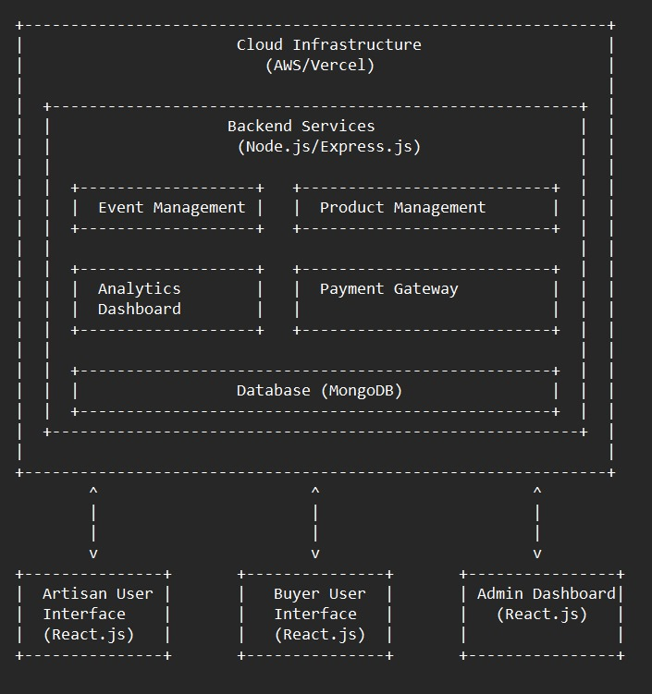
Architecture

Slide 9
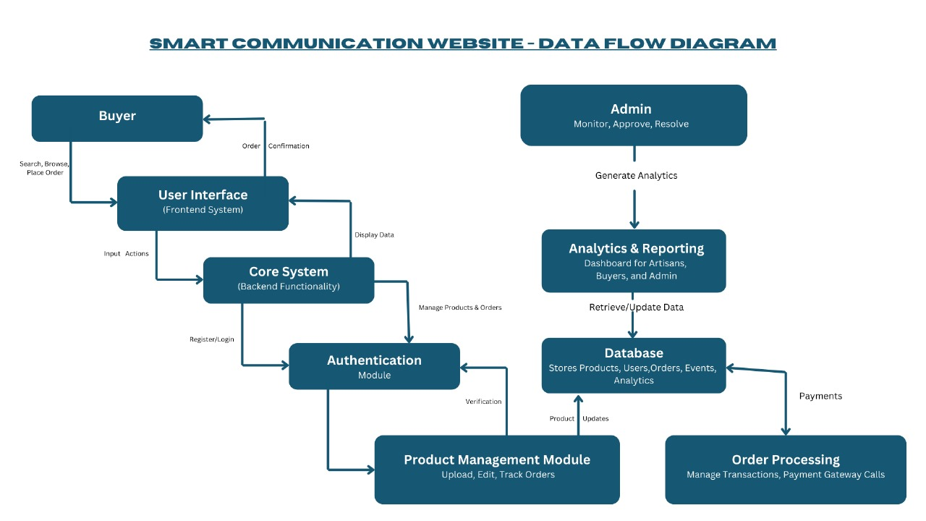
Data Flow Diagram

Slide 10
Hardware/software components
Technology | Details
Backend | Node.js
Frontend | HTML\CSS, React.js
Database | MongoDB
Payment | Stripe, Razorpay or paytm
Deployment | AWS or Vercel for scalability
Version Control | GitHub for collaboration and updates

Slide 11
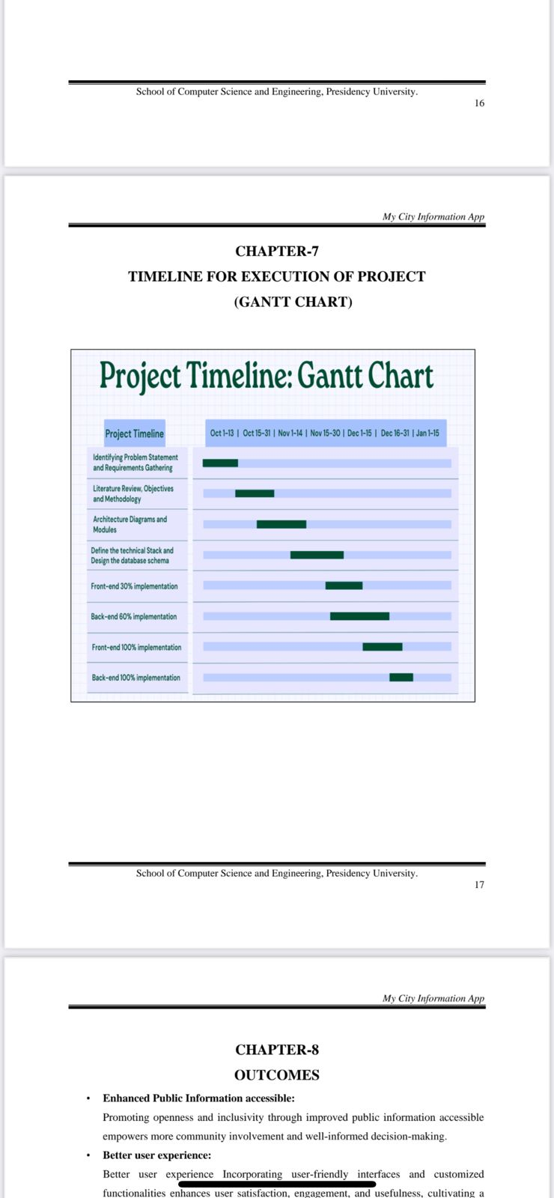
Timeline of Project (Gantt Chart)

Slide 12
Expected Outcomes
Economic Empowerment: Higher revenue through direct sales.
Cultural Preservation: Showcase local crafts on global platforms.
Increased Visibility: Promote participation in government events and exhibitions.
Others:
Reinforce benefits such as economic upliftment of rural artisans, global market exposure, and preservation of heritage crafts.
Mention how the platform bridges digital literacy gaps by offering user-friendly interfaces.
Discuss long-term benefits like artisan networking and innovation through community engagement.

Slide 13
Conclusion
Summary:
This project offers an excellent avenue for artisans both economically and in the preservation of their cultural practices.
In addition to providing trust in the form of cash on delivery COD options, the platform also allows users to form communities by creating events.
Using analytics and dashboard tools, artisans growth their sales and engagement.

Slide 14
Github Link
The Github link provided should have public access permission.
Github Link

Slide 15
References
GitHub Repository:
KalaKriti
ArtisanHub - Focus on regional crafts.
Meesho Case Study : Mobile-commerce platform for artisans.
Etsy Case Study : A marketplace for handcrafted products, with global reach​.
Other Internet sources
https://d1wqtxts1xzle7.cloudfront.net/105081538/E_Commerce_Website_for_Artisans
https://www.researchgate.net/profile/HubertEscaith/publication/356931583_Technolog Ecommerce_and_Handicrafts_When_traditional_creators_meet_21st_Century_businessmodels.pdf
https://d1wqtxts1xzle7.cloudfront.net/105081538/E_Commerce_Website_for_Artisans-libre.pdf?1692280230=&response-content-disposition=inline%3B+filename%3DE_Commerce_Website_for_Artisans.pdf
file:///C:/Users/CHITRIKA/OneDrive/Documents/Downloads/PaperpublishedKIIT-Dec-2019.pdf
https://voiceofresearch.org/Doc/Dec-2016/Dec-2016_7.pdf
https://www.researchgate.net/profile/Purvi-Derashri/publication/369742097_India's_Technological_Roadmap_for_MSMEs_Governance

Slide 16
Project work mapping with SDG
Sustainable Development Goal (SDG) | How It Relates to the Project
SDG 8: Decent Work and Economic Growth | Provides artisans with better income opportunities.
SDG 9: Industry, Innovation, and Infrastructure | Uses technology to build sustainable digital infrastructure for artisans.
SDG 10: Reduced Inequalities | Offers marginalized artisans access to global markets.
SDG 12: Responsible Consumption and Production | Encourages sustainable local crafts production.

Slide 17
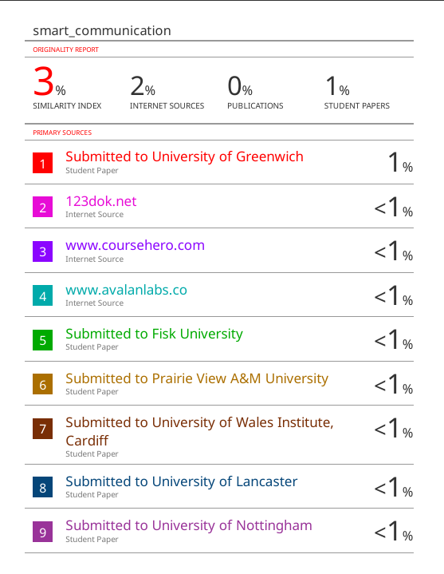
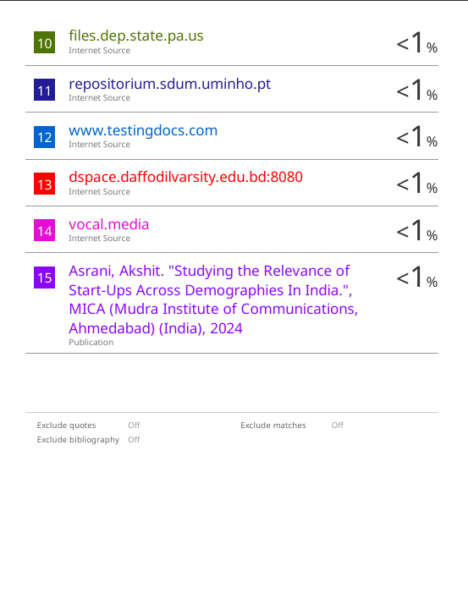
PLAGIARISM REPORT

Slide 18
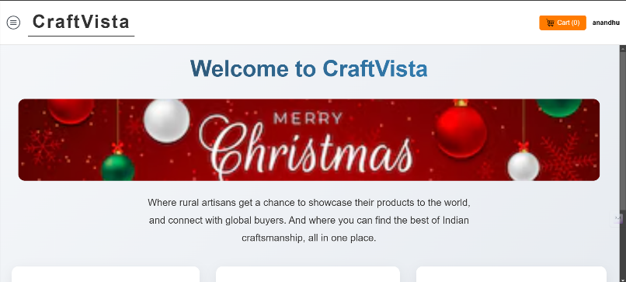
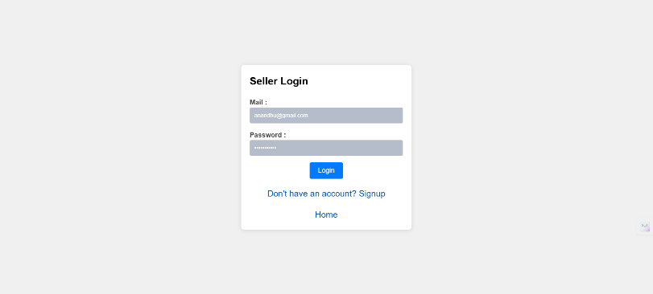
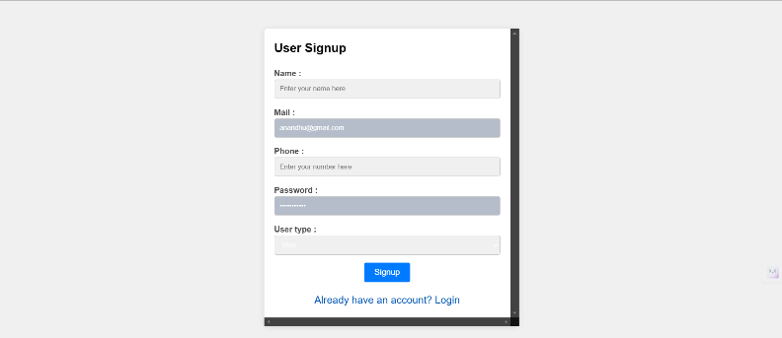
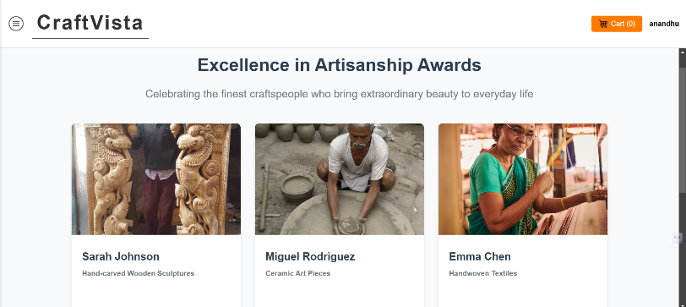
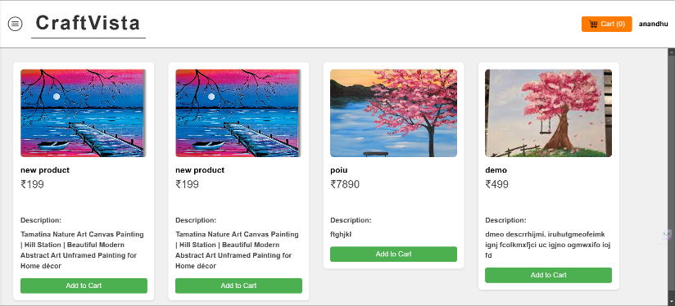
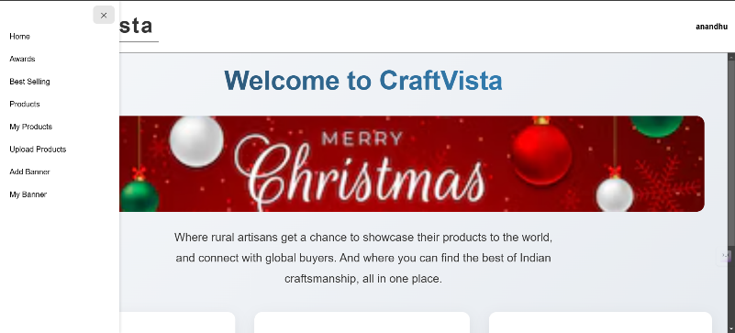
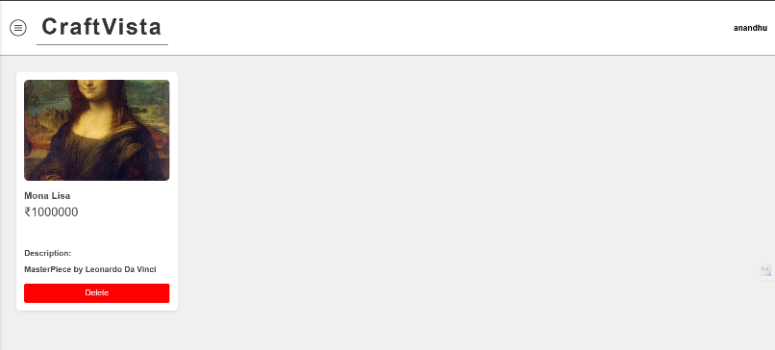
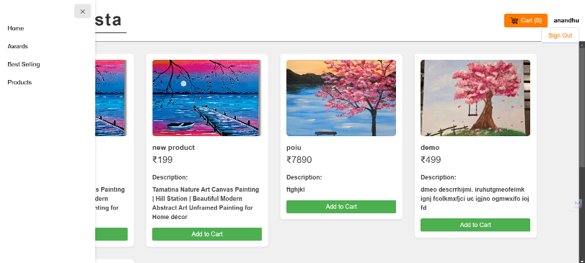
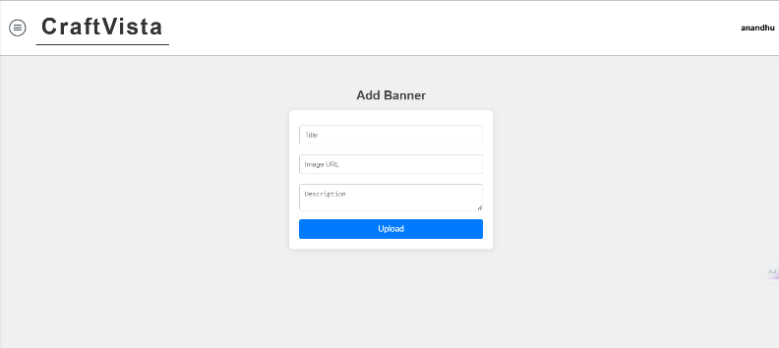
SCREENSHOTS – for references

Slide 19
Conclusion…
Thank You

